Slide 1

XBOX Accelerator Micro architecture
PRESENTATION
EILON & MIKE

Slide 2
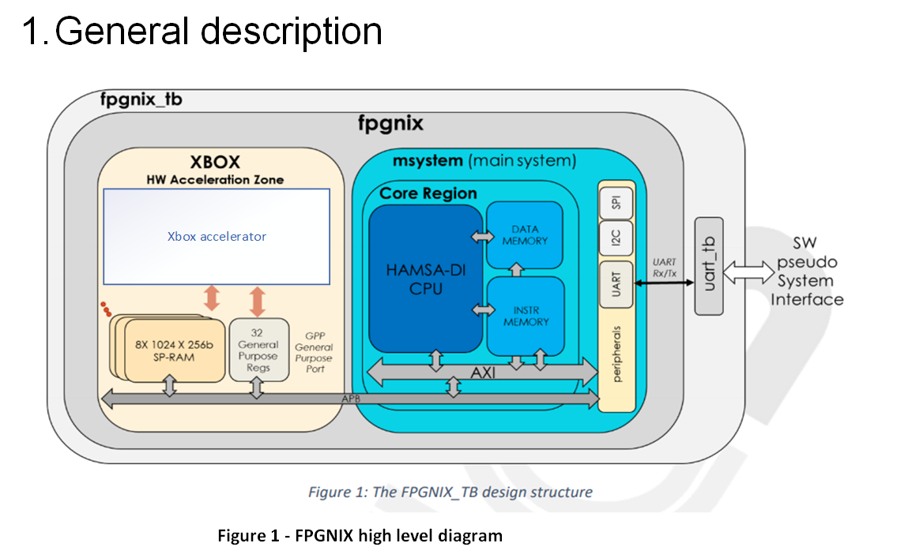

Slide 3
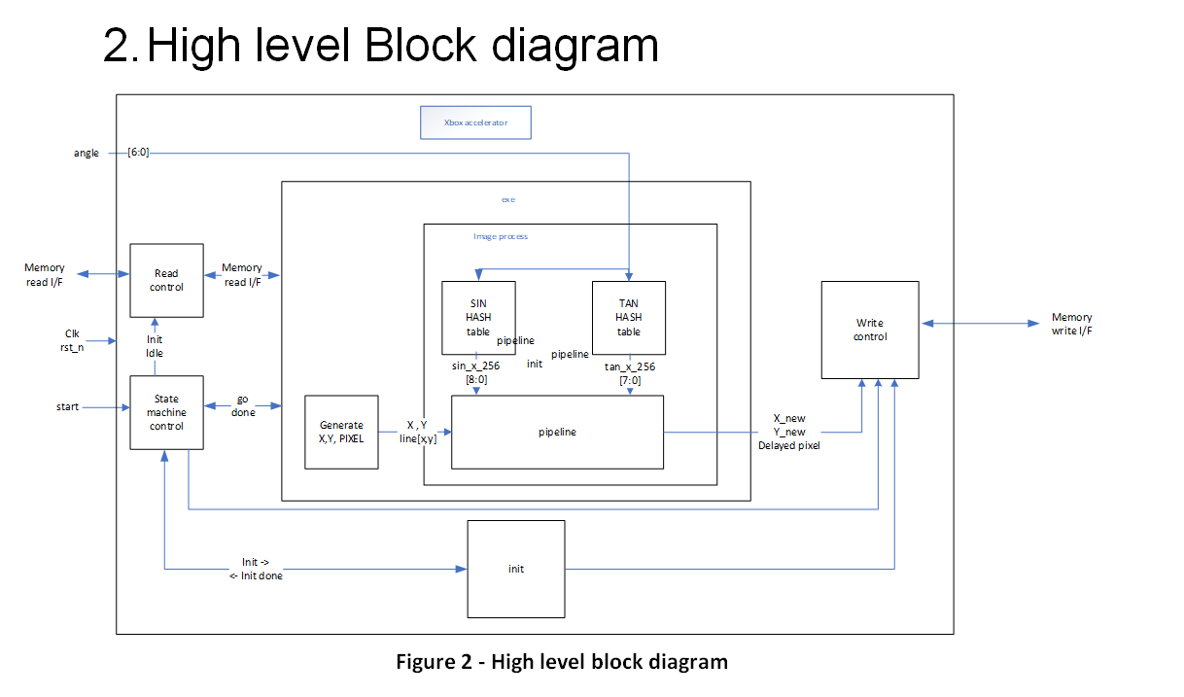

Slide 4
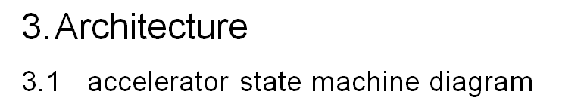
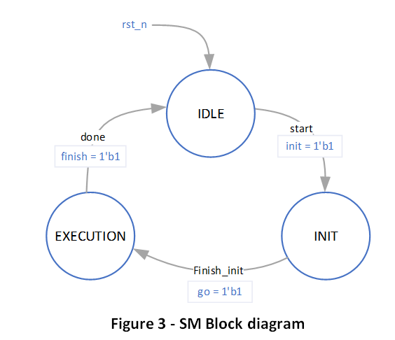

Slide 5

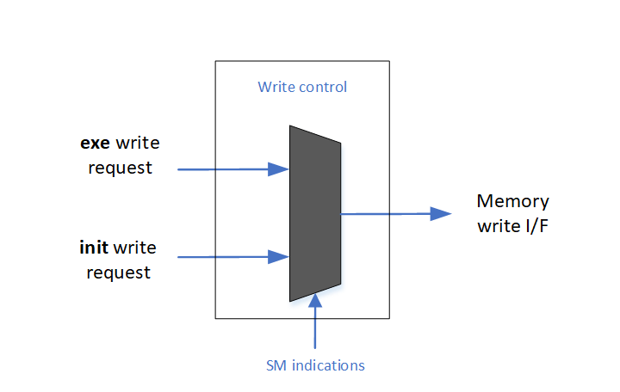

Slide 6

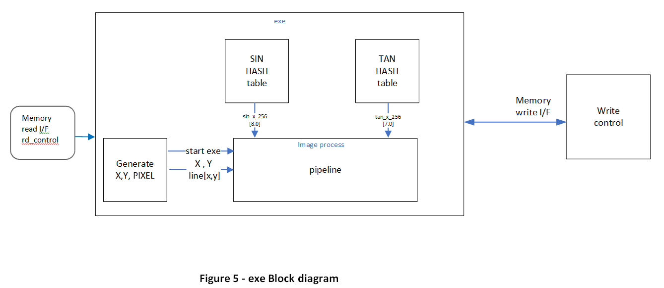

Slide 7
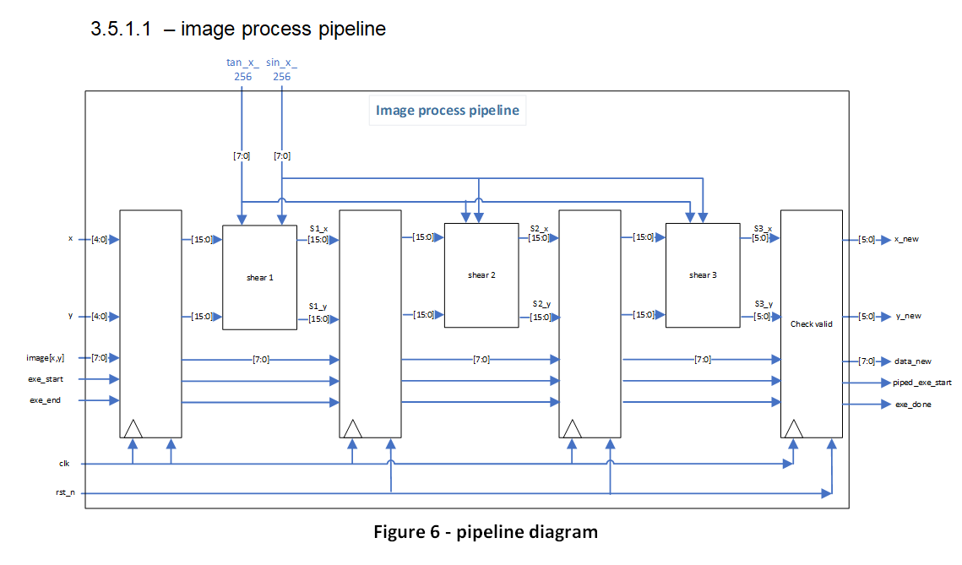

Slide 8
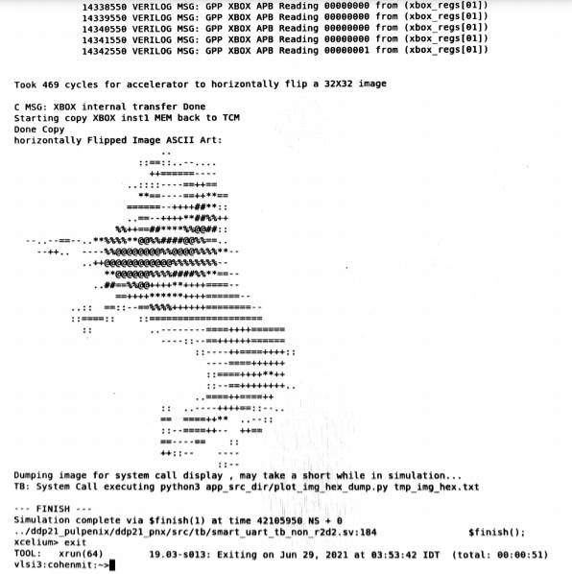
SIMULATION RESULTS :
469 CLK CYCLES

Slide 9
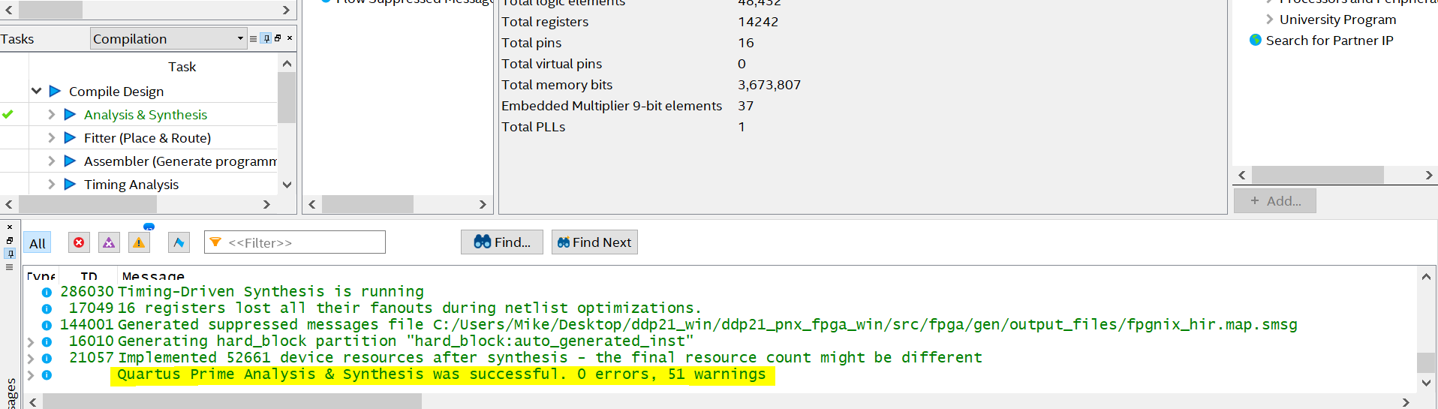
SYNTHESA & ANALYSIS
RESULTS :
PASSED

Slide 10
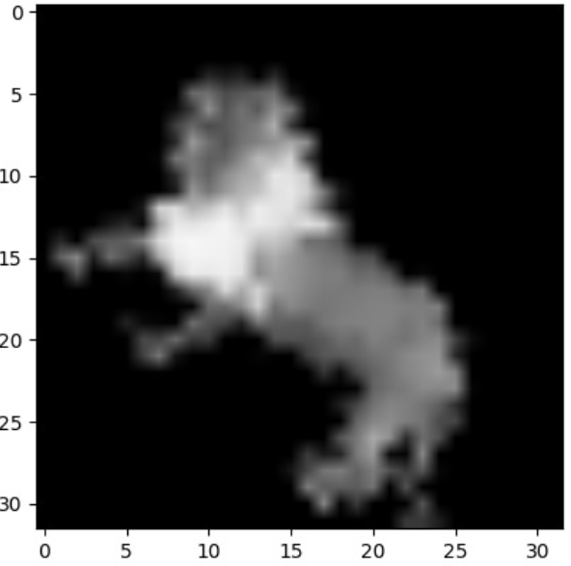
FITCHER RESULTS
469 CLK CYCLES

